Slide 1

SoC-Arch 2020/2021
Wellbeing Station
Project presentation
Brignone Giovanni, Castagneri Dario, Paganini Giovanni

Slide 2

Outline
Motivation
Background
Proposed solution
Results and discussions
Conclusions and future works

Slide 3
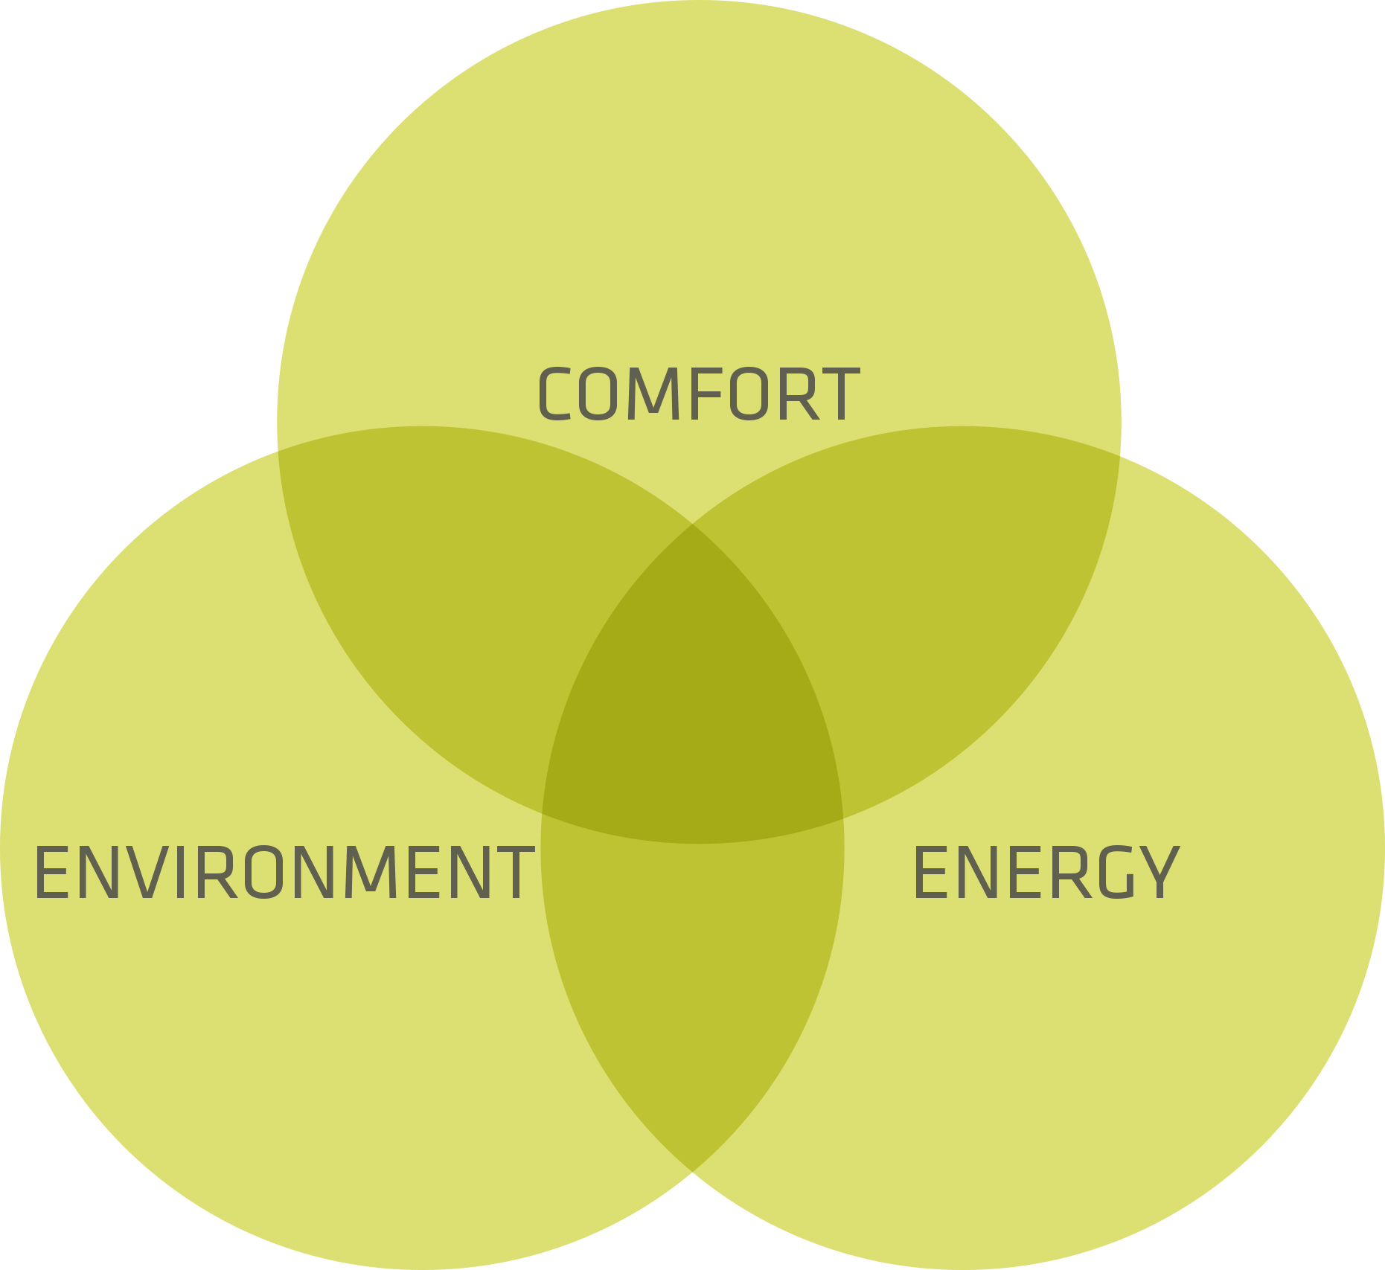
Motivation
Comfort means wellbeing and good health
Smart control to save energy and reduce impact on the environment
Outdoor conditions to influence indoor
Brignone Giovanni, Castagneri Dario, Paganini Giovanni - Politecnico di Torino

Slide 4
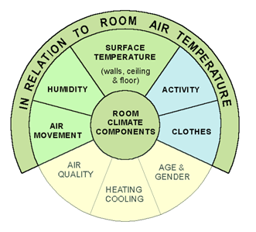
Background I
Room climate is affected by multiple factors
Key parameters are air temperature and relative humidity
Thermal comfort is obtained when two conditions are satisfied
Brignone Giovanni, Castagneri Dario, Paganini Giovanni - Politecnico di Torino

Slide 5
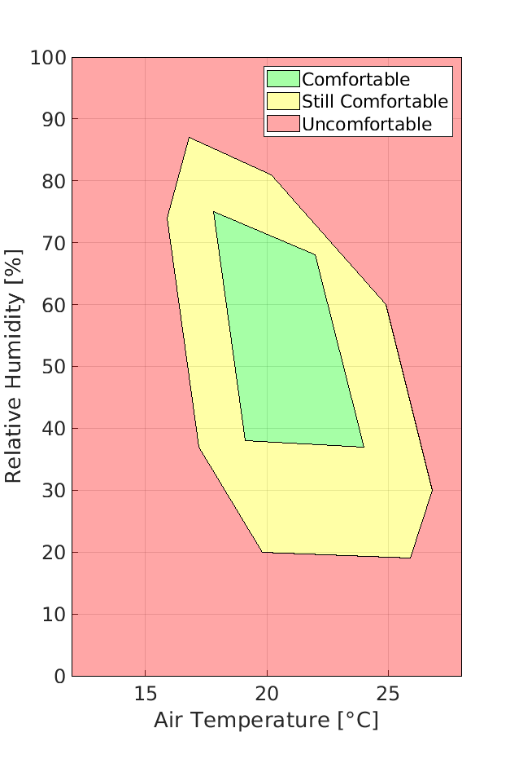
Background II
Human thermal wellness is subjective but assessable with physical quantities
Optimal and sub-optimal areas in relative humidity vs temperature plane according to Leusden and Freymark study
Brignone Giovanni, Castagneri Dario, Paganini Giovanni - Politecnico di Torino

Slide 6
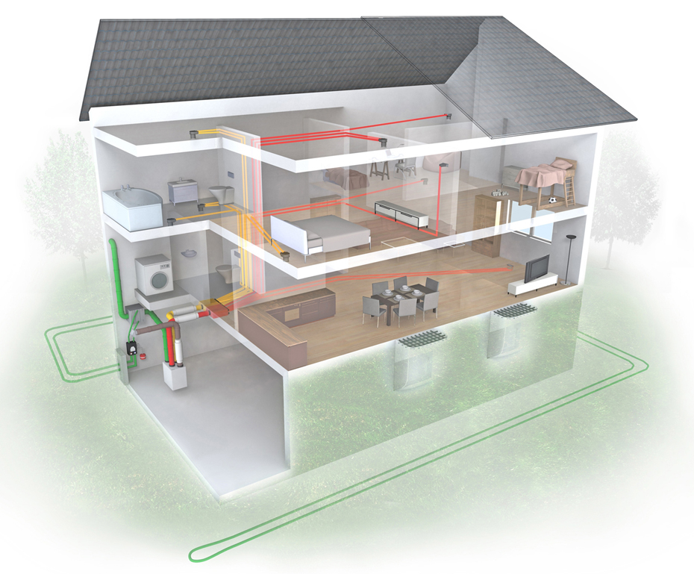
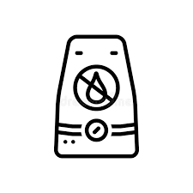


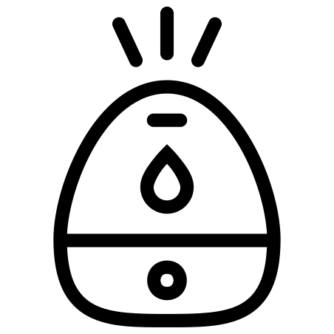

Proposed solution

Slide 7
Proposed solution
Outdoor
Temperature
Outdoor
Humidity
Indoor
Humidity
Indoor
Temperature
Comfort
Zone
Controller
Conditioning Devices
Heater
Cooler
Humidifier
Dehumidifier
Comfort
Control
Operating
Mode

Slide 8
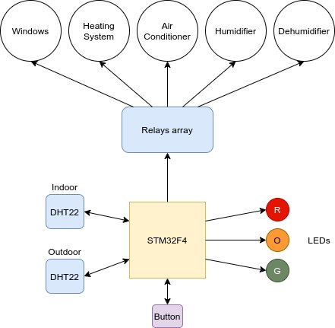
Proposed solution
Software
Hardware
Controller Comfort
Microcontroller
Sensors
Relays
RTC
I/O
Drivers

Slide 9
Proposed solution Controller
Comfort
HQ
ECO
OFF
Energy consumption
Brignone Giovanni, Castagneri Dario, Paganini Giovanni - Politecnico di Torino

Slide 10
Proposed solution Controller
Day-time
Comfort
Night-time
HQ
ECO
OFF
Energy consumption
Brignone Giovanni, Castagneri Dario, Paganini Giovanni - Politecnico di Torino

Slide 11
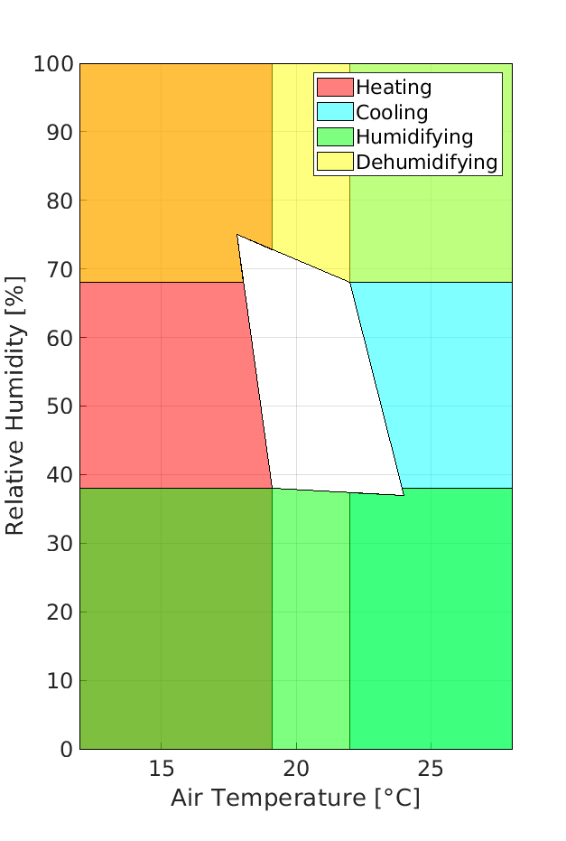
Proposed solution Controller - HQ Mode
Target: Comfortable Zone as soon as possible
Policy: one threshold for each Active Device: activate when threshold is passed

Slide 12
Proposed solution Controller -ECO Mode
Target: avoid Uncomfortable Zone while minimizing energy consumption
Policy:
Convenient outdoor: Passive Devices
Non-convenient outdoor: Active Devices
ECO
Passive devices
Active devices
Check outdoor
Control
Convenient
Non-convenient

Slide 13
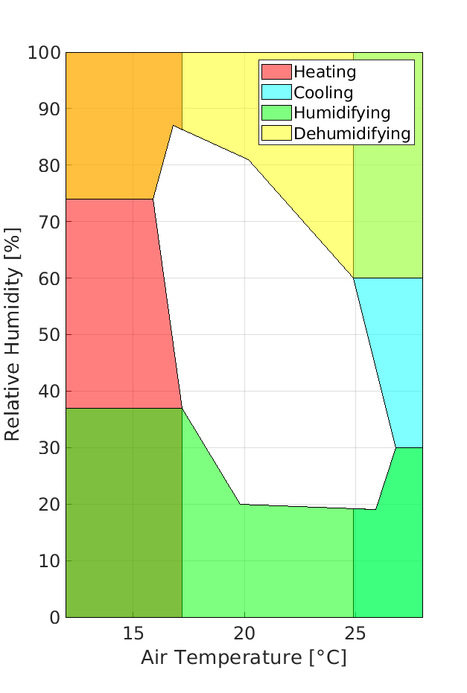
Proposed solution Controller -ECO Mode
Non-convenient outdoor conditions:
Target: Still Comfortable Zone, limiting energy consumption
Policy: enable Active Devices, prioritizing low-power ones

Slide 14
Proposed solution Controller -ECO Mode
Prioritize dehumidifying
over cooling
Non-convenient outdoor conditions:
Target: Still Comfortable Zone, limiting energy consumption
Policy: enable Active Devices, prioritizing low-power ones
Prioritize humidifying
over heating

Slide 15
Outline
Motivation
Background
Proposed solution
Results and discussions
Conclusions and future works

Slide 16


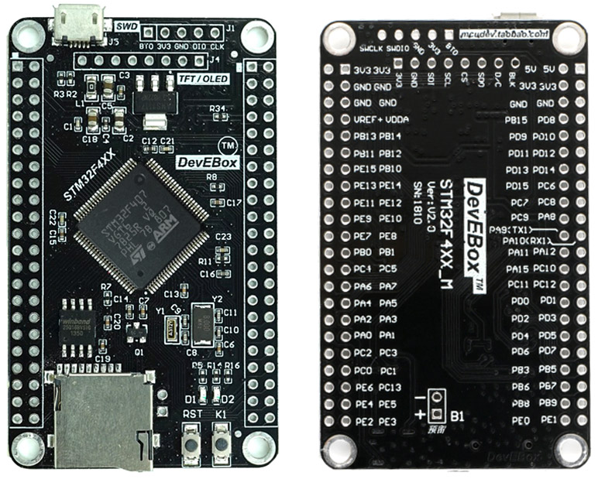
Results and Discussion
Development and test were divided in two parts:
Phase I: Initial simulation based on Renode Environment
Phase II: Porting to real hardware

Slide 17
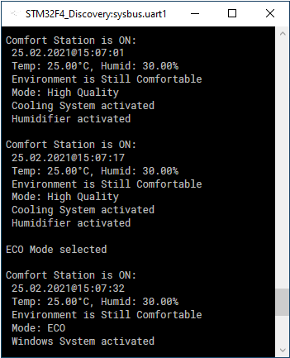
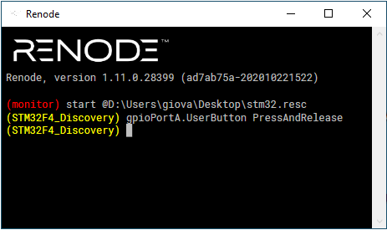
Results and Discussion
Phase I - Initial simulation based on Renode Environment:
Implementation of the correct behavior
Correctness of the controller logic
DHT Sensors simulated injecting values in memory
Mode switching support
External LEDs and Relays as output on UART

Slide 18
Results and Discussion
Phase I - Initial simulation based on Renode Environment:
Implementation of the correct behavior
Correctness of the controller logic
DHT Sensors simulated injecting values in memory
Mode switching support
External LEDs and Relays as output on UART

Slide 19
Results and Discussion
Phase I - Initial simulation based on Renode Environment:
Implementation of the correct behavior
Correctness of the controller logic
DHT Sensors simulated injecting values in memory
Mode switching support
External LEDs and Relays as output on UART

Slide 20
Results and Discussion
Phase I - Initial simulation based on Renode Environment:
Implementation of the correct behavior
Correctness of the controller logic
DHT Sensors simulated injecting values in memory
Mode switching support
External LEDs and Relays as output on UART

Slide 21
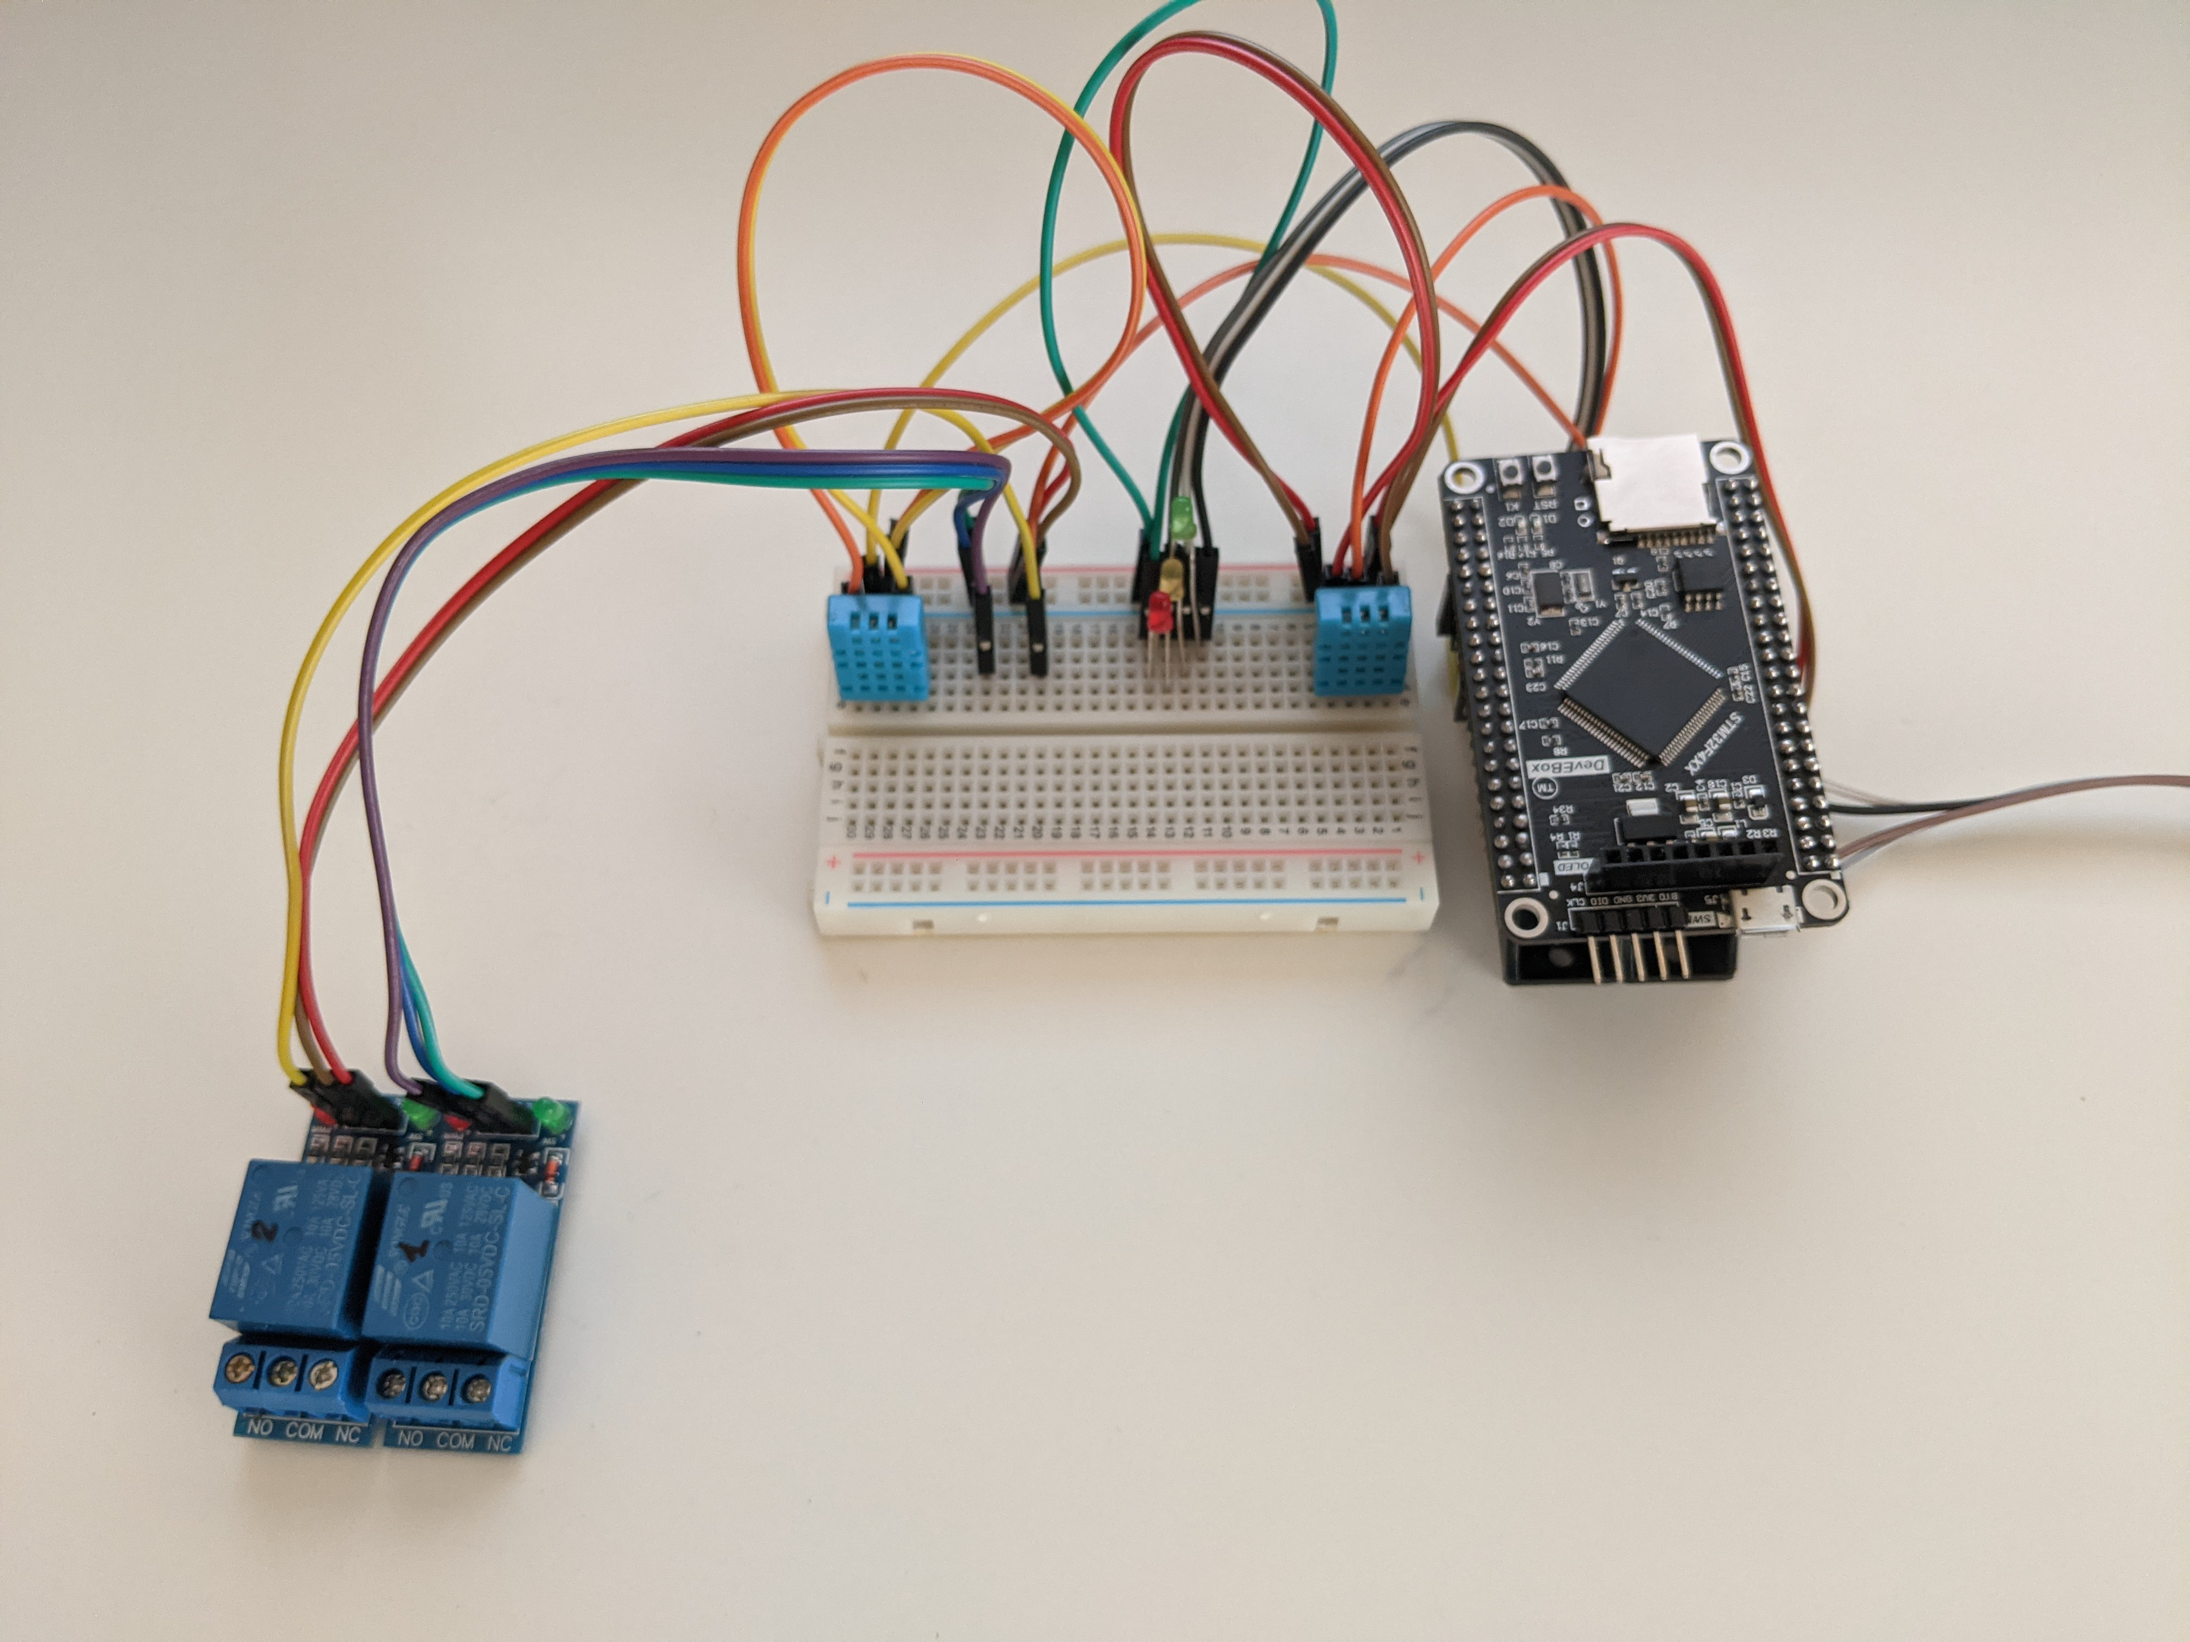
Results and Discussion
Phase II - Porting to the real Hardware:
DevEBox STM32F407VG board
Correctness of data read and outputs behavior
Some troubles with DHT Sensors due to their timing
Bounce effect on mode button
LEDs and Relays arrays remapped according to board pinout

Slide 22
Conclusions and future works
A possible solution to control indoor parameters
Special attention to power consumption and environment
Need more tests with different scenarios

Slide 23




Conclusions and future works
Great margin of improvement
Usability
Wireless sensors
Multi-room support
Functionality
Parameters and time slots customization
Internet access
Accessibility
Touchscreen
Mobile app

